Slide 1
PAWS-X: A Cross-lingual Adversarial Dataset for Paraphrase Identification
Weber Huang (黃彥鈞)
Graduate Student of Data Science Dept, TMU

Slide 2
About the Author
Google Research
Yinfei Yang , Yuan Zhang , Chris Tar , Jason Baldridge
Google AI blog

Slide 3
Outline
1. Introduction
1-1 Why PAWS-X ?
1-2 What is PAWS-X?
2. Method
2-1 Evaluated Methods
2-2 Experiments and Results
3. Conclusion

Slide 4
Introduction
Why PAWS-X ?
What is PAWS-X?

Slide 5

Introduction - Why PAWS-X ? - What is PAWS-X? Method - Evaluated Methods - Experiments and Results Conclusion
Adversarial examples have effectively highlighted the deﬁciencies of state-of-the-art models for many natural language processing tasks
PAWS, which has adversarial paraphrase identiﬁcation pairs with high lexical overlap.
E.g. flights from New York to Florida vs flights from Florida to New York
Research on adversarial examples has generally shown that augmenting training data with good adversarial examples can boost performance for some models

Slide 6
Introduction - Why PAWS-X ? - What is PAWS-X? Method - Evaluated Methods - Experiments and Results Conclusion
Most previous work focuses only on English despite the fact that the problems highlighted by adversarial examples are shared by other languages.
E.g. Multi30K , Opusparcus
PAWS - X
PAWS
English only
Spanish, French, German, Chinese,
Japanese, and Korean

Slide 7
Introduction - Why PAWS-X ? - What is PAWS-X? Method - Evaluated Methods - Experiments and Results Conclusion
PAWS-X
23,659 pairs
Human translated data
49,401 pairs
Machine translated data from PAWS

Slide 8


Introduction - Why PAWS-X ? - What is PAWS-X? Method - Evaluated Methods - Experiments and Results Conclusion
PAWS-X
Training data
Test data
Development
data

Slide 9
Introduction - Why PAWS-X ? - What is PAWS-X? Method - Evaluated Methods - Experiments and Results Conclusion
3 advantages of translation instead of repeating the PAWS data generation approach :
human translation does not require high-quality multilingual part-of-speech taggers or named entity recognizers.
human translators are trained to produce the target sentence while preserving meaning, thereby ensuring high data quality.
the resulting data can provide a new testbed for cross-lingual transfer techniques because examples in all languages are translated from the same sources.

Slide 10
Introduction - Why PAWS-X ? - What is PAWS-X? Method - Evaluated Methods - Experiments and Results Conclusion
Translating Evaluation Sets
Obtaining human translations on a random sample of 4,000 sentence pairs from the PAWS development set for each of the six languages
A randomly sampled subset is presented and validated by a second worker. The ﬁnal delivery is guaranteed to have less than 5% word level error rate.
The sampled 4,000 pairs are split into new development and test sets, 2,000 pairs for each.
development sets
2000 pairs
Human translated data
4,000 sentence pairs if each language
test sets
2000 pairs

Slide 11
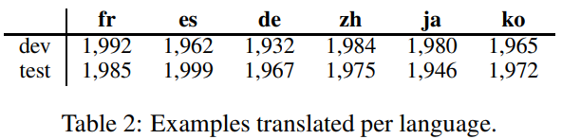
Introduction - Why PAWS-X ? - What is PAWS-X? Method - Evaluated Methods - Experiments and Results Conclusion
Some sentences could not be translated. Table 2 shows the ﬁnal counts translated to each language.
Incompleteness, ambiguities
likely from the Adversarial generation process when creating PAWS
< 2%
Original PAWS labels (paraphrase or not paraphrase) are mapped to the translations. Positive pairs account for 44.0% of development sets and 45.4% of test respectively–close to the PAWS label distribution.
Entity mention problem

Slide 12
Method
Evaluated Methods
Experiments and Results

Slide 13
Introduction - Why PAWS-X ? - What is PAWS-X? Method - Evaluated Methods - Experiments and Results Conclusion
PAWS-X : Probe models’ ability to capture structure and context in a multilingual setting.
BOW encoder with COS similarity
Unigram to bigram token
ESIM(Enhanced Sequential Inference Model)
BiLSTM
BERT(Bidirectional Encoder Representations from Transformers)
feed-forward layer
Cosine value > 0.5 as a paraphrase

Slide 14
Introduction - Why PAWS-X ? - What is PAWS-X? Method - Evaluated Methods - Experiments and Results Conclusion
Translate Train
Translate Test
Zero Shot
Merged
Evaluated
Strategies
All models
BERT only

Slide 15
Introduction - Why PAWS-X ? - What is PAWS-X? Method - Evaluated Methods - Experiments and Results Conclusion
Translate Train:
English training data is machine-translated into each target language to provide data to train each model.
Translate Test:
Train a model using the English training data, and machine-translate all test examples to English for evaluation.
Zero Shot:
The model is trained on the PAWS English training data, and then directly evaluated on all others. Machine translation is not involved in this strategy.
Merged:
Train a multilingual model on all languages, including the original English pairs and machine-translated data in all other languages.

Slide 16
Introduction - Why PAWS-X ? - What is PAWS-X? Method - Evaluated Methods - Experiments and Results Conclusion
BERT :
Latest public multilingual BERT base model with 12 layers2 and apply the default ﬁne-tuning strategy with batch size 32 and learning rate 1e-5.
BOW and ESIM :
using their own implementations and 300 dimensional multilingual word embeddings from fastText.
Two metrics :
Classiﬁcation accuracy
Area-under-curve scores of precision-recall curves (AUC-PR)

Slide 17
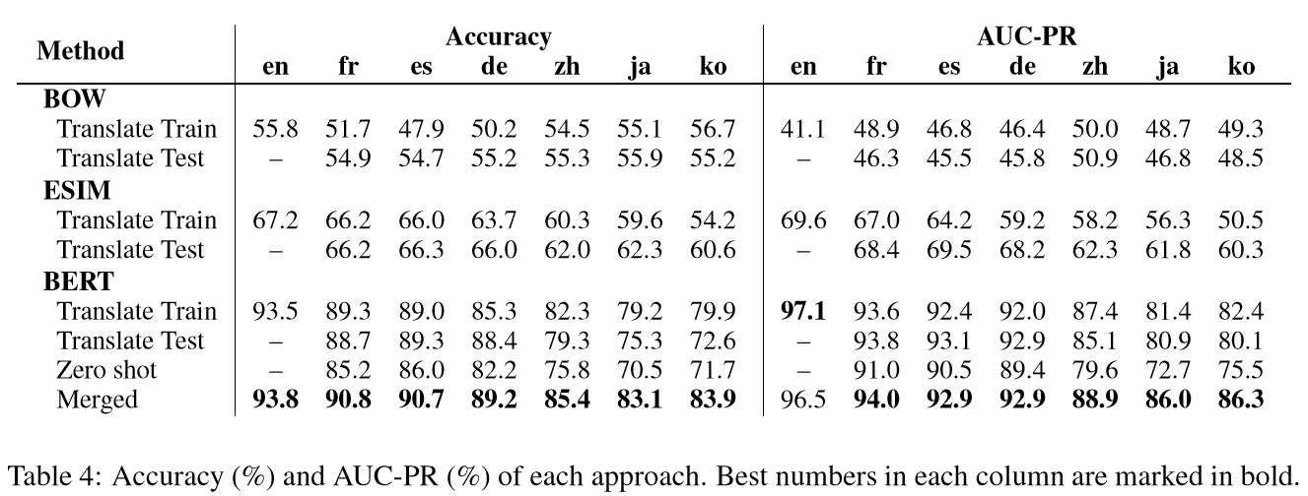
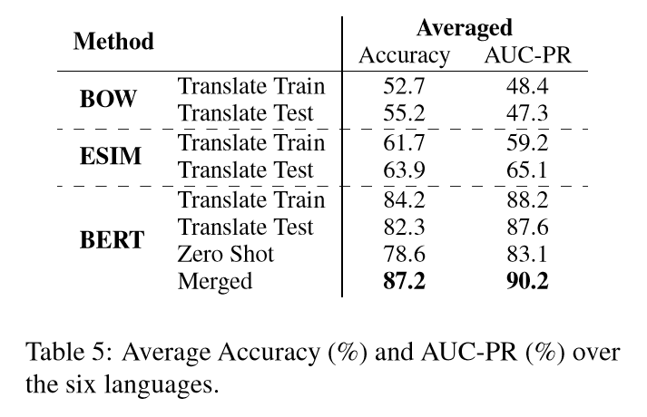
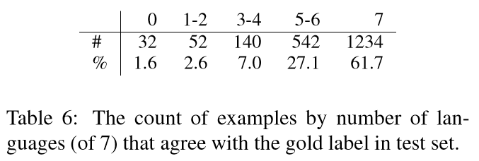
Introduction - Why PAWS-X ? - What is PAWS-X? Method - Evaluated Methods - Experiments and Results Conclusion
Model Comparisons
Training/Evaluation Strategies
Language Difference
Error Analysis

Slide 18
Conclusion

Slide 19
Introduction - Why PAWS-X ? - What is PAWS-X? Method - Evaluated Methods - Experiments and Results Conclusion
Our experimental results showed that PAWS-X effectively measures sensitivity of models to word order and the efﬁcacy of cross-lingual learning approaches.
It also leaves considerable headroom as a new challenging benchmark to drive multilingual research on the problem of paraphrase identiﬁcation.
The PAWS-X dataset, including both the new human translated pairs and the machine translated examples, is available for download at https://github.com/google-research-datasets/paws.

Slide 20
Q & A

